Slide 1
Word Sense Disambiguation
Based on slides by
Prof. Raymond J. Mooney (U T Austin)
Prof. Christopher Manning (Stanford Univ.)
&
Prof. Dan Jurafsky (Stanford Univ.)

Slide 2
Lexical Ambiguity
Most words in natural languages have multiple possible meanings.
  “pen” (noun)
    The dog is in the pen.
    The ink is in the pen.
  “take” (verb)
    Take one pill every morning.
    Take the first right past the stoplight.
Syntax helps distinguish meanings for different parts of speech of an ambiguous word.
  “conduct” (noun or verb)
    John’s conduct in class is unacceptable.
    John will conduct the orchestra on Thursday.

Slide 3
Motivation for
Word Sense Disambiguation (WSD)
Many tasks in natural language processing require disambiguation of ambiguous words.
  Question Answering
  Information Retrieval
  Machine Translation
  Text Mining
  Phone Help Systems
Understanding how people disambiguate words is an interesting problem that can provide insight in psycholinguistics.

Slide 4
Sense Inventory
What is a “sense” of a word?
  Homonyms (disconnected meanings)
    bank: financial institution
    bank: sloping land next to a river
  Polysemes (related meanings with joint etymology)
    bank: financial institution as corporation
    bank: a building housing such an institution
Sources of sense inventories
  Dictionaries
  Lexical databases

Slide 5
WordNet
A detailed database of semantic relationships between English words.
Developed by famous cognitive psychologist George Miller and a team at Princeton University.
About 144,000 English words.
Nouns, adjectives, verbs, and adverbs grouped into about 109,000 synonym sets called synsets.

Slide 6
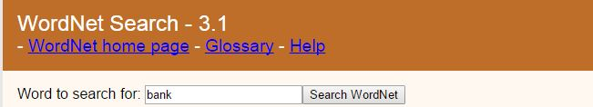
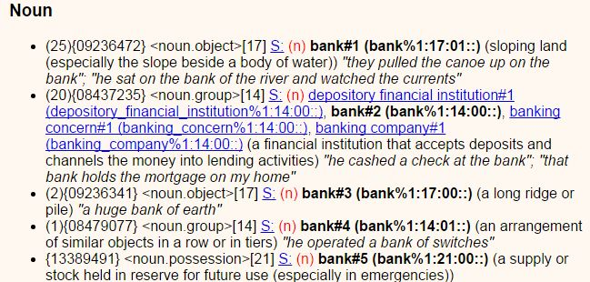
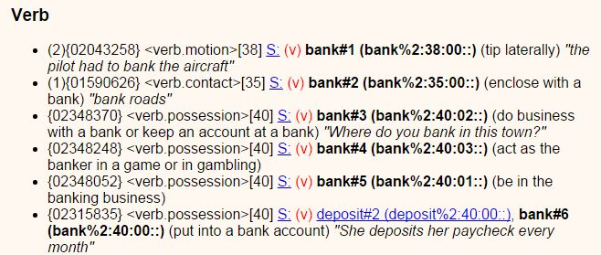
WordNet Synset Relationships

Slide 7
WordNet Synset Relationships
Antonym: front → back
Attribute: benevolence → good (noun to adjective)
Pertainym: alphabetical → alphabet (adjective to noun)
Similar: unquestioning → absolute
Cause: kill → die
Entailment: breathe → inhale
Holonym: chapter → text (part to whole)
Meronym: computer → cpu (whole to part)
Hyponym: plant → tree (specialization)
Hypernym: apple → fruit (generalization)

Slide 8
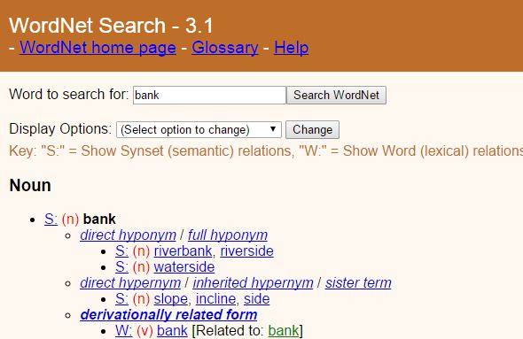
WordNet Synset Relationships

Slide 9
EuroWordNet
WordNets for
  Dutch
  Italian
  Spanish
  German
  French
  Czech
  Estonian
  http://www.illc.uva.nl/EuroWordNet/

Slide 10
WordNet Senses
WordNets senses (like many dictionary senses) tend to be very fine-grained.
“play” as a verb has 35 senses, including
  play a role or part: “Gielgud played Hamlet”
  pretend to have certain qualities or state of mind: “John played dead.”
Difficult to disambiguate to this level for people and computers. Only expert lexicographers are perhaps able to reliably differentiate senses.
Not clear such fine-grained senses are useful for NLP.
Several proposals for grouping senses into coarser, easier to identify senses (e.g. homonyms only).

Slide 11
Senses Based on Needs of Translation
Only distinguish senses that are translate to different words in some other language.
  play: tocar vs. jugar (spanish)
  know: conocer (spanish) vs. saber (portugese)
  be: ser (portugese) vs. estar (spanish)
  leave: salir vs dejar (spanish)
  take: llevar vs. tomar vs. sacar (spanish)
May still require overly fine-grained senses
  river in French is either:
    fleuve: flows into the ocean
    rivière: does not flow into the ocean

Slide 12
WSD Methods
Supervised Machine Learning
Thesaurus/Dictionary Methods
Semi-Supervised Learning

Slide 13
Word Sense Disambiguation
Supervised Machine Learning
13

Slide 14
Supervised Machine Learning Approaches
Supervised machine learning approach:
  a training corpus of words tagged in context with their sense
  used to train a classifier that can tag words in new text
Summary of what we need:
  the tag set (“sense inventory”)
  the training corpus
  A set of features extracted from the training corpus
  A classifier
14

Slide 15
Supervised WSD 1: WSD Tags
What’s a tag?
  A dictionary sense?
For example, for WordNet an instance of “bass” in a text has 8 possible tags or labels (bass1 through bass8).
15

Slide 16
8 senses of “bass” in WordNet
bass - (the lowest part of the musical range)
bass, bass part - (the lowest part in polyphonic music)
bass, basso - (an adult male singer with the lowest voice)
sea bass, bass - (flesh of lean-fleshed saltwater fish of the family Serranidae)
freshwater bass, bass - (any of various North American lean-fleshed freshwater fishes especially of the genus Micropterus)
bass, bass voice, basso - (the lowest adult male singing voice)
bass - (the member with the lowest range of a family of musical instruments)
bass - (nontechnical name for any of numerous edible marine and freshwater spiny-finned fishes)
16

Slide 17
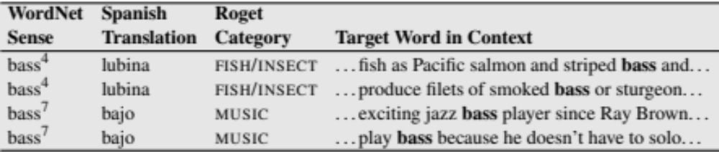
Inventory of sense tags for bass
17

Slide 18
Supervised WSD 2: Get a corpus
Lexical sample:
  Choose one or more ambiguous words each with a sense inventory.
  From a larger corpus, assemble sample occurrences of these words.
  Have humans mark each occurrence with a sense tag.
All words:
  Select a corpus of sentences.
  For each ambiguous word in the corpus, have humans mark it with a sense tag from an broad-coverage lexical database (e.g. WordNet).
    SemCor: 234,000 words from Brown Corpus, manually tagged with WordNet senses
    SENSEVAL-3 competition corpora - 2081 tagged word tokens

Slide 19
Supervised WSD 3: Feature Engineering
The success of machine learning requires instances to be represented using an effective set of features that are correlated with the categories of interest.
Feature engineering can be a laborious process that requires substantial human expertise and knowledge of the domain.
In NLP it is common to extract many (even thousands of) potentially useful features and use a learning algorithm that works well with many relevant and irrelevant features.

Slide 20
Intuition from Warren Weaver (1955):
  “If one examines the words in a book, one at a time as through an opaque mask with a hole in it one word wide, then it is obviously impossible to determine, one at a time, the meaning of the words…
  But if one lengthens the slit in the opaque mask, until one can see not only the central word in question but also say N words on either side, then if N is large enough one can unambiguously decide the meaning of the central word…
  The practical question is : ``What minimum value of N will, at least in a tolerable fraction of cases, lead to the correct choice of meaning for the central word?”
<number>0

Slide 21
Contextual Features
Surrounding bag of words.
POS of neighboring words
Local collocations
Syntactic relations
Experimental evaluations indicate that all of these features are useful; and the best results comes from integrating all of these cues in the disambiguation process.

Slide 22
Surrounding Bag of Words
Unordered individual words near the ambiguous word.
Words in the same sentence.
May include words in the previous sentence or surrounding paragraph.
Gives general topical cues of the context.
May use feature selection to determine a smaller set of words that help discriminate possible senses.
May just remove common “stop words” such as articles, prepositions, etc.

Slide 23
POS of Neighboring Words
Use part-of-speech of immediately neighboring words.
Provides evidence of local syntactic context.
P_{-i} is the POS of the word i positions to the left of the target word.
P_{i} is the POS of the word i positions to the right of the target word.
Typical to include features for:
P₋₃, P₋₂, P₋₁, P₁, P₂, P₃

Slide 24
Local Collocations
Specific lexical context immediately adjacent to the word.
For example, to determine if “interest” as a noun refers to “readiness to give attention” or “money paid for the use of money”, the following collocations are useful:
  “in the interest of”
  “an interest in”
  “interest rate”
  “accrued interest”
C_{i,j} is a feature of the sequence of words from local position i to j relative to the target word.
  C_{-2,1} for “in the interest of” is “in the of”
Typical to include:
  Single word context: C_{-1,-1} , C_{1,1}, C_{-2,-2}, C_{2,2}
  Two word context: C_{-2,-1}, C_{-1,1} ,C_{1,2}
  Three word context: C_{-3,-1}, C_{-2,1}, C_{-1,2}, C_{1,3}

Slide 25
Syntactic Relations
(Ambiguous Verbs)
For an ambiguous verb, it is very useful to know its direct object.
  “played the game”
  “played the guitar”
  “played the risky and long-lasting card game”
  “played the beautiful and expensive guitar”
  “played the big brass tuba at the football game”
  “played the game listening to the drums and the tubas”
May also be useful to know its subject:
  “The game was played while the band played.”
  “The game that included a drum and a tuba was played on Friday.”

Slide 26
Syntactic Relations
(Ambiguous Nouns)
For an ambiguous noun, it is useful to know what verb it is an object of:
  “played the piano and the horn”
  “wounded by the rhinoceros’ horn”
May also be useful to know what verb it is the subject of:
  “the bank near the river loaned him $100”
  “the bank is eroding and the bank has given the city the money to repair it”

Slide 27
Syntactic Relations
(Ambiguous Adjectives)
For an ambiguous adjective, it useful to know the noun it is modifying.
  “a brilliant young man”
  “a brilliant yellow light”
  “a wooden writing desk”
  “a wooden acting performance”

Slide 28
Using Syntax in WSD
Produce a parse tree for a sentence using a syntactic parser.
For ambiguous verbs, use the head word of its direct object and of its subject as features.
For ambiguous nouns, use verbs for which it is the object and the subject as features.
For ambiguous adjectives, use the head word (noun) of its NP as a feature.
S
NP
VP
ProperN
V
NP
John
played
DET
N
the
piano

Slide 29
Supervised WSD 4: Learning for WSD
Assume part-of-speech (POS), e.g. noun, verb, adjective, for the target word is determined.
Treat as a classification problem with the appropriate potential senses for the target word given its POS as the categories.
Encode context using a set of features to be used for disambiguation.
Train a classifier on labeled data encoded using these features.
Use the trained classifier to disambiguate future instances of the target word given their contextual features.

Slide 30
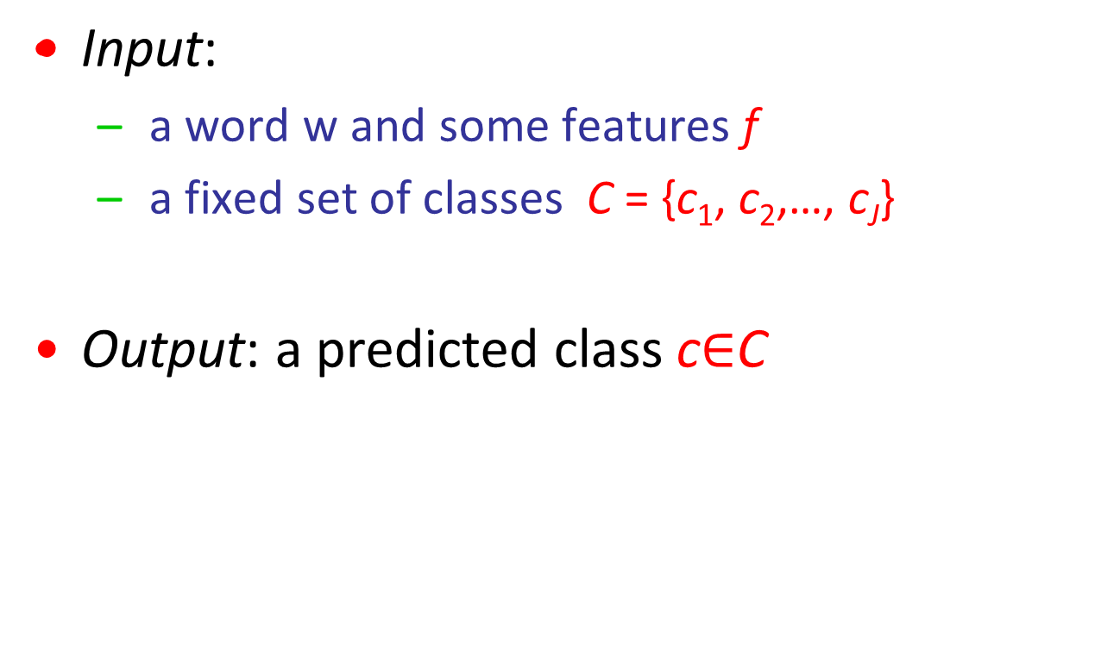
Classification: definition
30

Slide 31
Classification Methods:
Supervised Machine Learning
Input:
  a word w in a text window d (which we’ll call a “document”)
  a fixed set of classes C = {c₁, c₂,…, c_{J}}
  A training set of m hand-labeled text windows again called “documents” (d₁,c₁),....,(d_{m},c_{m})
Output:
  a learned classifier γ:d → c

Slide 32
Learning Algorithms
Naïve Bayes
  Binary features
K Nearest Neighbor
  Simple instance-based algorithm with k=3 and Hamming distance
Perceptron
  Simple neural-network algorithm.
C4.5
  State of the art decision-tree induction algorithm
PFOIL-DNF
  Simple logical rule learner for Disjunctive Normal Form
PFOIL-CNF
  Simple logical rule learner for Conjunctive Normal Form
PFOIL-DLIST
  Simple logical rule learner for decision-list of conjunctive rules
Notes:
Naïve Bayes classification with example:
http://nlp.stanford.edu/IR-book/html/htmledition/naive-bayes-text-classification-1.html#tab:nbtoy

Slide 33
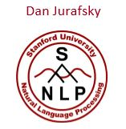
Applying Naive Bayes to WSD
P(c) is the prior probability of that sense
  Counting in a labeled training set.
P(w|c) conditional probability of a word given a particular sense
  P(w|c) = count(w,c)/count(c)
We get both of these from a tagged corpus like SemCor
Can also generalize to look at other features besides words.
  Then it would be P(f|c)
    Conditional probability of a feature given a sense
33

Slide 34
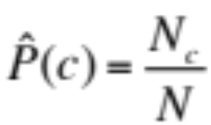
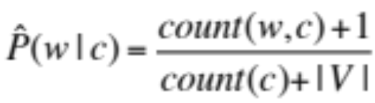



Applying Naive Bayes to WSD
 | Doc | Words | Class
Training | 1 | fish smoked fish | f
 | 2 | fish line | f
 | 3 | fish haul smoked | f
 | 4 | guitar jazz line | g
Test | 5 | line guitar jazz jazz | ?
Priors:
P(f) =
P(g) =
3
V = {fish, smoked, line, haul, guitar, jazz}
4
1
4
Choosing a class:
P(f|d5)
Conditional Probabilities:
P(line|f) =
P(guitar|f) =
P(jazz|f) =
P(line|g) =
P(guitar|g) =
P(jazz|g) =
  3/4 * 2/14 * (1/14)² * 1/14
  ≈ 0.00003
(1+1) / (8+6) = 2/14
(0+1) / (8+6) = 1/14
(0+1) / (8+6) = 1/14
(1+1) / (3+6) = 2/9
(1+1) / (3+6) = 2/9
P(g|d5)
  1/4 * 2/9 * (2/9)² * 2/9
  ≈ 0.0006
(1+1) / (3+6) = 2/9

Slide 35
Nearest-Neighbor Learning Algorithm
Learning is just storing the representations of the training examples in D.
Testing instance x:
  Compute similarity between x and all examples in D.
  Assign x the category of the most similar example in D.
Does not explicitly compute a generalization or category prototypes.
Also called:
  Case-based
  Memory-based
  Lazy learning

Slide 36
K Nearest-Neighbor
Using only the closest example to determine categorization is subject to errors due to:
  A single atypical example.
  Noise (i.e. error) in the category label of a single training example.
More robust alternative is to find the k most-similar examples and return the majority category of these k examples.
Value of k is typically odd to avoid ties, 3 and 5 are most common.

Slide 37
Similarity Metrics
Nearest neighbor method depends on a similarity (or distance) metric.
Simplest for continuous m-dimensional instance space is Euclidian distance.
Simplest for m-dimensional binary instance space is Hamming distance (number of feature values that differ).
For text, cosine similarity of TF-IDF weighted vectors is typically most effective.
Notes:
Euclidian distance, Hamming distance, cosine similarity:
http://aimotion.blogspot.com/2009/09/data-mining-in-practice.html
http://www-users.cs.umn.edu/~kumar/dmbook/dmslides/chap2_data.pdf
http://slidewiki.org/deck/1487_measuring-data-similarity-and-dissimilarity#tree-1487-slide-22363-13-view

Slide 38
3 Nearest Neighbor Illustration
(Euclidian Distance)
.
.
.
.
.
.
.
.
.
.
.

Slide 39
Perceptron
Simple neural-net learning algorithm that learns the synaptic weights on a single model neuron.
Iterative weight-update algorithm is guaranteed to learn a linear separator that correctly classifies the training data whenever such a function exists.

Slide 40
Decision Tree Learning
Categorization function can be represented by decision trees.
Decision tree learning algorithms attempt to find the smallest decision tree that is consistent with the training data.
color
red
green
blue
shape
-
-
circle
square
triangle
+
-
-

Slide 41
Rule Learning
DNF learning algorithms try to find smallest logical disjunction of conjunctions consistent with the training data.
  (red and circle) or (blue and triangle)
CNF learning algorithms try to find smallest logical conjunction of disjunctions consistent with the training data.
  (red or blue) and (triangle or large)

Slide 42
Decision List Learning
A decision list is an ordered list of conjunctive rules. The first rule to apply is used to classify an instance.
  red & circle → positive
  large → negative
  triangle → positive
  true → negative
Decision list learner tries to find the smallest decision list consistent with the training data.

Slide 43
Decision Lists and Language
Decision lists work well to encode the system of rules and exceptions in many linguistic regularities.
Example from English past tense formation:
  If word ends in “eep” replace with “ept” (e.g. slept, wept, kept)
  If word ends in “ay” add “ed” (e.g. played, delayed)
  If word ends in “y” replace with “ied” (e.g. spied, cried)
  If word ends in “e” add “d” (e.g. dated, rotated)
  If true add “ed” (e.g. talked, walked)
Example from disambiguating “line”:
  If followed by “of poetry” label it “text”
  If preceded by “place in” label it “formation”
  If it is the object of “develop” label it “product”
  If sentence has “phone” label it “phone”
  If sentence has “fish” label it “cord”
  If true label it “division”

Slide 44
Evaluation of WSD
“In vitro”:
  Corpus developed in which one or more ambiguous words are labeled with explicit sense tags according to some sense inventory.
  Corpus used for training and testing WSD and evaluated using accuracy (percentage of labeled words correctly disambiguated).
    Use most common sense selection as a baseline.
“In vivo”:
  Incorporate WSD system into some larger application system, such as machine translation, information retrieval, or question answering.
  Evaluate relative contribution of different WSD methods by measuring performance impact on the overall system on final task (accuracy of MT, IR, or QA results).

Slide 45
Evaluating Categorization
Evaluation must be done on test data that are independent of the training data (usually a disjoint set of instances).
Classification accuracy: c/n where n is the total number of test instances and c is the number of test instances correctly classified by the system.
Results can vary based on sampling error due to different training and test sets.
Average results over multiple training and test sets (splits of the overall data) for the best results.

Slide 46
N-Fold Cross-Validation
Ideally, test and training sets are independent on each trial.
  But this would require too much labeled data.
Partition data into N equal-sized disjoint segments.
Run N trials, each time using a different segment of the data for testing, and training on the remaining N−1 segments.
This way, at least test-sets are independent.
Report average classification accuracy over the N trials.
Typically, N = 10.

Slide 47
Learning Curves
In practice, labeled data is usually rare and expensive.
Would like to know how performance varies with the number of training instances.
Learning curves plot classification accuracy on independent test data (Y axis) versus number of training examples (X axis).

Slide 48
N-Fold Learning Curves
Want learning curves averaged over multiple trials.
Use N-fold cross validation to generate N full training and test sets.
For each trial, train on increasing fractions of the training set, measuring accuracy on the test data for each point on the desired learning curve.

Slide 49
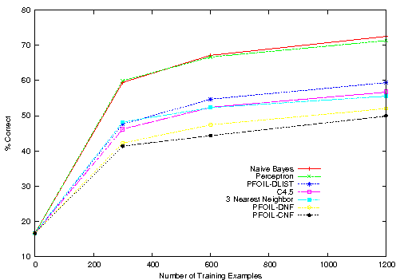
Learning Curves for WSD of “line”

Slide 50
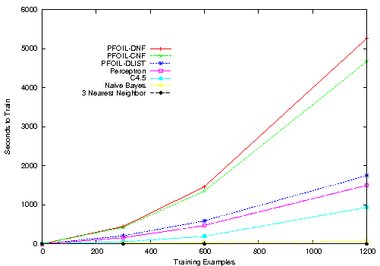
Train Time Curves for WSD of “line”

Slide 51
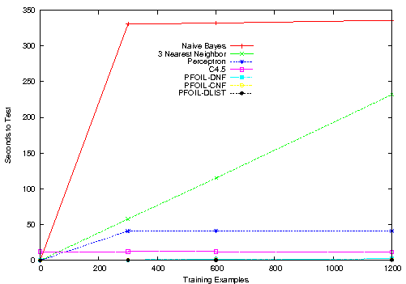
Test Time Curves for WSD of “line”

Slide 52
Word Sense Disambiguation
Dictionary and Thesaurus Methods
52

Slide 53
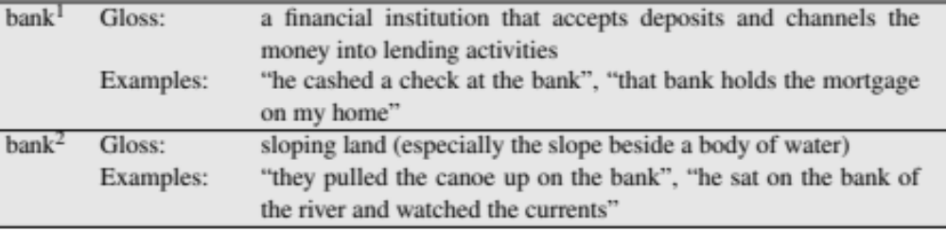
The Simplified Lesk algorithm
Let’s disambiguate “bank” in this sentence:
  The bank can guarantee deposits will eventually cover future tuition costs because it invests in adjustable-rate mortgage securities.
given the following two WordNet senses:
53

Slide 54
The Simplified Lesk algorithm
Choose sense with most word overlap between gloss and context
(not counting function words)
  The bank can guarantee deposits will eventually cover future tuition costs because it invests in adjustable-rate mortgage securities.
54

Slide 55
The Corpus Lesk algorithm
Assumes we have some sense-labeled data
Take all the sentences with the relevant word sense:
  These short, "streamlined" meetings usually are sponsored by local banks¹, Chambers of Commerce, trade associations, or other civic organizations.
Now add these to the gloss + examples for each sense, call it the “signature” of a sense.
Choose sense with most word overlap between context and signature.
55

Slide 56
Corpus Lesk: IDF weighting
Instead of just removing function words
  Weigh each word by its `promiscuity’ across documents
  Down-weights words that occur in every `document’ (gloss, example, etc)
  These are generally function words, but is a more fine-grained measure
Weigh each overlapping word by inverse document frequency
56

Slide 57
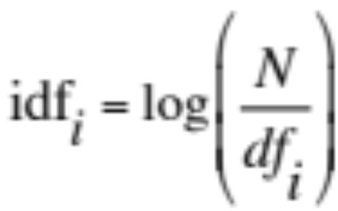
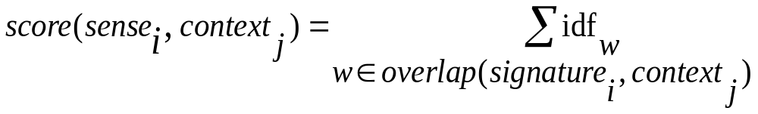
Corpus Lesk: IDF weighting
Weigh each overlapping word by inverse document frequency
  N is the total number of documents
  df_{i} = “document frequency of word i”
  = # of documents with word i
57

Slide 58
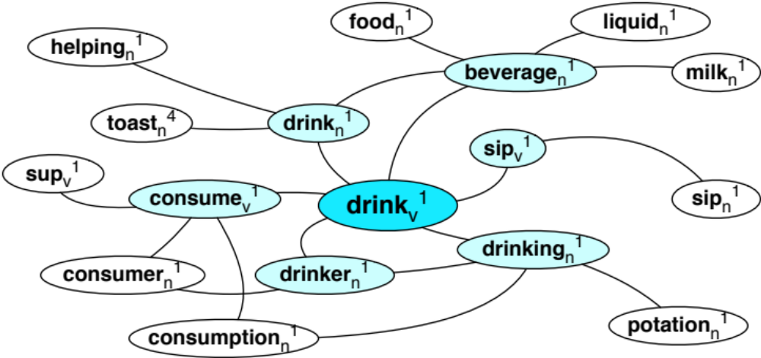
Graph-based methods
First, WordNet can be viewed as a graph
  senses are nodes
  relations (hypernymy, meronymy) are edges
  Also add edge between word and unambiguous gloss words
58

Slide 59
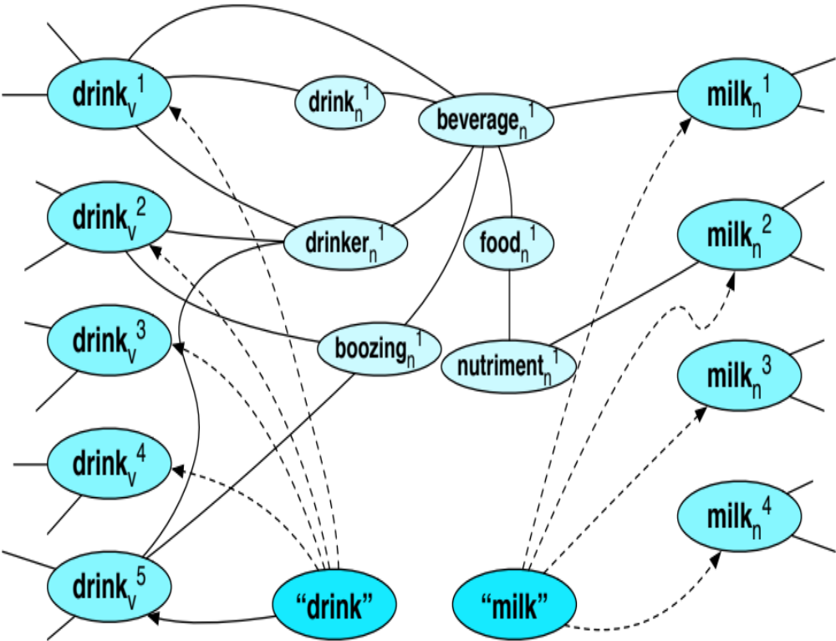
How to use the graph for WSD
Insert target word and words in its sentential context into the graph, with directed edges to their senses
“She drank some milk”
Now choose the
most central sense
Add some probability to
“drink” and “milk” and
compute node with
highest “pagerank”
59

Slide 60
Word Sense Disambiguation
Semi-Supervised Learning
60

Slide 61
Semi-Supervised Learning
Problem: supervised and dictionary-based approaches require large hand-built resources
  What if you don’t have so much training data?
Solution: Bootstrapping
  Generalize from a very small hand-labeled seed-set.
61

Slide 62
Bootstrapping
For bass
  Rely on “One sense per collocation” rule
    A word reoccurring in collocation with the same word will almost surely have the same sense.
  the word play occurs with the music sense of bass
  the word fish occurs with the fish sense of bass
62

Slide 63
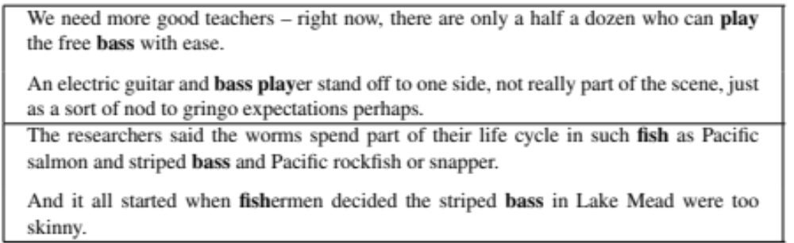
Sentences extracting using “fish” and “play”
63

Slide 64
Summary: generating seeds
Hand labeling
“One sense per collocation”:
  A word reoccurring in collocation with the same word will almost surely have the same sense.
“One sense per discourse”:
  The sense of a word is highly consistent within a document - Yarowsky (1995)
  (At least for non-function words, and especially topic-specific words)
64

Slide 65
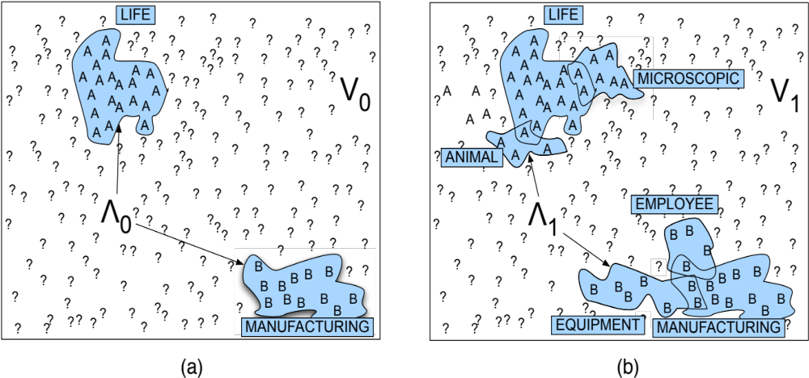
Stages in the Yarowsky bootstrapping algorithm for the word “plant”
65

Slide 66
Summary
Word Sense Disambiguation: choosing correct sense in context
Applications: MT, QA, etc.
Three classes of Methods
  Supervised Machine Learning: Naive Bayes classifier
  Thesaurus/Dictionary Methods: Lesk algorithm
  Semi-Supervised Learning
Main intuition
  There is lots of information in a word’s context
  Simple algorithms based just on word counts can be surprisingly good
66

Slide 67
Appendix

Slide 68
SenseEval
Standardized international “competition” on WSD.
Organized by the Association for Computational Linguistics (ACL) Special Interest Group on the Lexicon (SIGLEX).
Events:
  Senseval 1: 1998
  Senseval 2: 2001
  Senseval 3: 2004
  Evolved to:
  Semeval 2007, 2010, 2012, 2013, 2014, 2015, 2016 (TBH)
Notes:
https://en.wikipedia.org/wiki/SemEval

Slide 69
Senseval 1: 1998
Datasets for
  English
  French
  Italian
Lexical sample in English
  Noun: accident, behavior, bet, disability, excess, float, giant, knee, onion, promise, rabbit, sack, scrap, shirt, steering
  Verb: amaze, bet, bother, bury, calculate, consumer, derive, float, invade, promise, sack, scrap, sieze
  Adjective: brilliant, deaf, floating, generous, giant, modest, slight, wooden
  Indeterminate: band, bitter, hurdle, sanction, shake
Total number of ambiguous English words tagged: 8,448

Slide 70
Senseval 1 English Sense Inventory
Senses from the HECTOR lexicography project.
Multiple levels of granularity
  Coarse grained (avg. 7.2 senses per word)
  Fine grained (avg. 10.4 senses per word)

Slide 71
Senseval Metrics
Fixed training and test sets, same for each system.
System can decline to provide a sense tag for a word if it is sufficiently uncertain.
Measured quantities:
  A: number of words assigned senses
  C: number of words assigned correct senses
  T: total number of test words
Metrics:
  Precision = C/A
  Recall = C/T

Slide 72
Senseval 1 Overall English Results
 | Fine grained precision (recall) | Course grained precision (recall)
Human Lexicographer Agreement | 97% (96%) | 97% (97%)
Most common sense baseline | 57% (50%) | 63% (56%)
Best system | 77% (77%) | 81% (81%)

Slide 73
Senseval 2: 2001
More languages: Chinese, Danish, Dutch, Czech, Basque, Estonian, Italian, Korean, Spanish, Swedish, Japanese, English
Includes an “all-words” task as well as lexical sample.
Includes a “translation” task for Japanese, where senses correspond to distinct translations of a word into another language.
35 teams competed with over 90 systems entered.

Slide 74
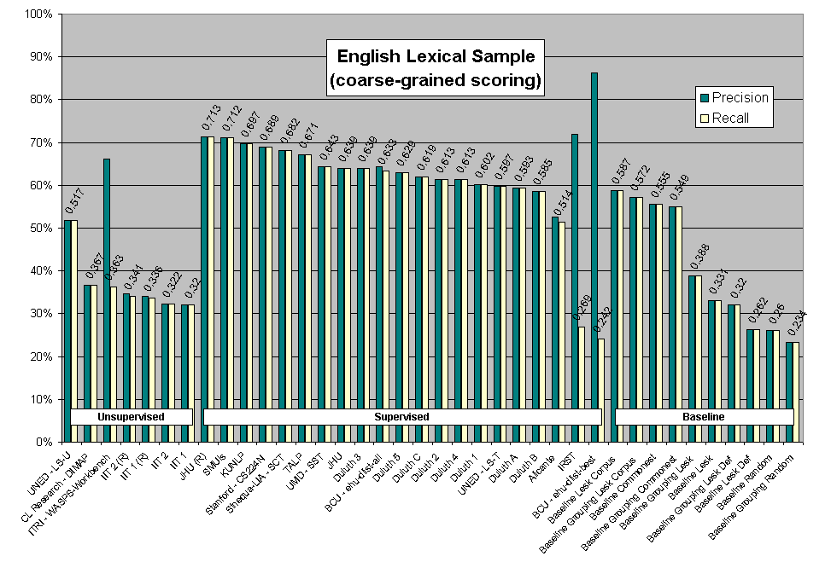
Senseval 2 Results

Slide 75
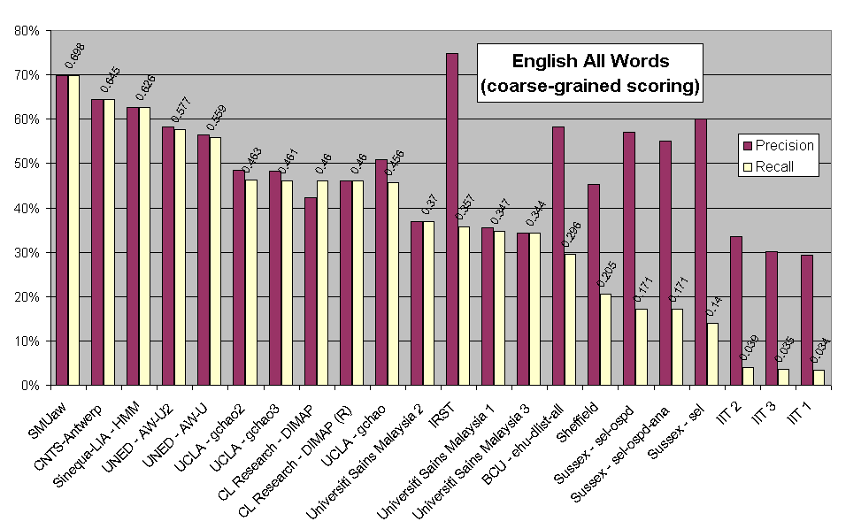
Senseval 2 Results

Slide 76
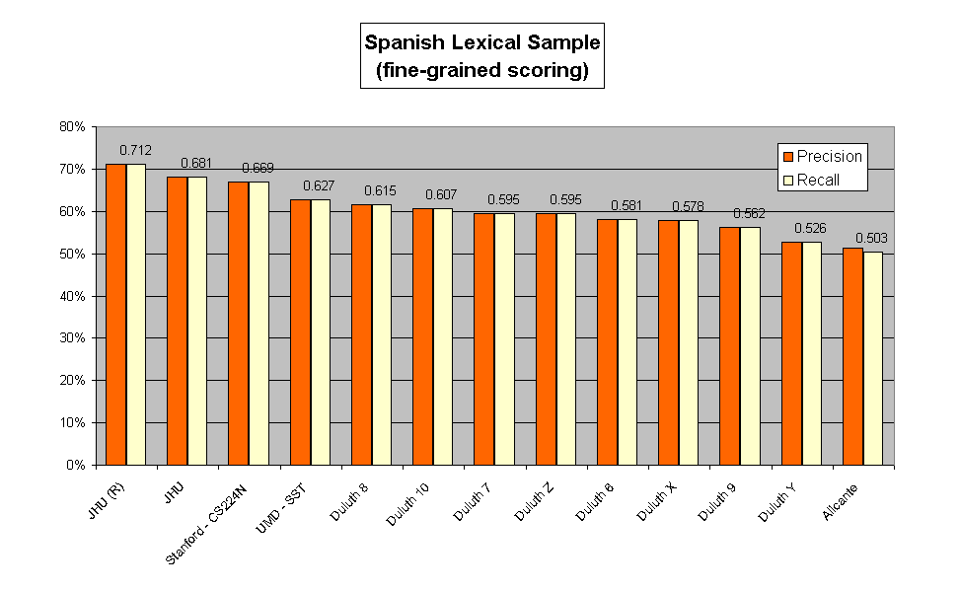
Senseval 2 Results

Slide 77
Ensemble Models
Systems that combine results from multiple approaches seem to work very well.
Training Data
. . .
System 1
System 2
System 3
System n
Result 1
Result 2
Result 3
Result n
Combine Results
(weighted voting)
Final Result

Slide 78
Senseval 3: 2004
Some new languages: English, Italian, Basque, Catalan, Chinese, Romanian
Some new tasks
  Subcategorization acquisition
  Semantic role labelling
  Logical form

Slide 79
Senseval 3 English Lexical Sample
Volunteers over the web used to annotate senses of 60 ambiguous nouns, adjectives, and verbs.
Non expert lexicographers achieved only 62.8% inter-annotator agreement for fine senses.
Best results again in the low 70% accuracy range.

Slide 80
Senseval 3: English All Words Task
5,000 words from Wall Street Journal newspaper and Brown corpus (editorial, news, and fiction)
2,212 words tagged with WordNet senses.
Interannotator agreement of 72.5% for people with advanced linguistics degrees.
  Most disagreements on a smaller group of difficult words. Only 38% of word types had any disagreement at all.
Most-common sense baseline: 60.9% accuracy
Best results from competition: 65% accuracy

Slide 81
Other Approaches to WSD
Active learning
Unsupervised sense clustering
Semi-supervised learning
  Bootstrap from a small number of labeled examples to exploit unlabeled data
  Exploit “one sense per discourse”
Dictionary based methods
  Lesk algorithm
Notes:
Lesk Algorithm:
https://en.wikipedia.org/wiki/Lesk_algorithm

Slide 82
Issues in WSD
What is the right granularity of a sense inventory?
Integrating WSD with other NLP tasks
  Syntactic parsing
  Semantic role labeling
  Semantic parsing
Does WSD actually improve performance on some real end-user task?
  Information retrieval
  Information extraction
  Machine translation
  Question answering

